Slide 1

USA PERFORMANCE℠
Manage Performance, Ensure Success
OPM’s Performance Management System for Federal Agencies
USA Performance Training for Administrators – Day 2
[insert Agency Name]
[insert date]
OFFICIAL USE NOTICE: This material is intended exclusively for use by USA Performance Customers and is not to be distributed without approval from the USA Performance Program Office. This communication may contain information that is proprietary, privileged, confidential or otherwise legally exempt from disclosure. If you have received this presentation in error, please notify the USA Performance Program Office immediately and delete all copies of the material.

Slide 2
Today’s Agenda
Day 1 Review
Create and Manage Users
System Configuration
Organizational Performance Planning
Check on Learning

Slide 3
Create and Manage Users

Slide 4
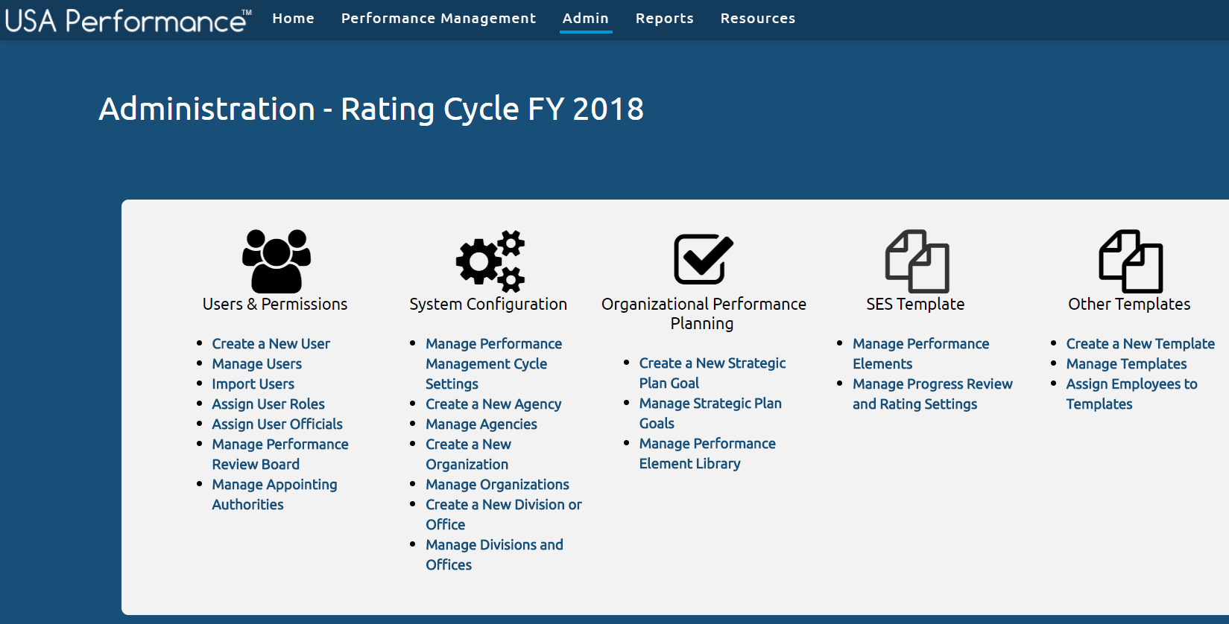
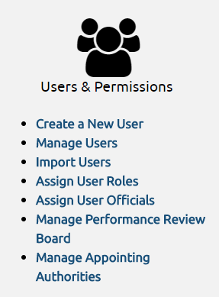

How to Create a User Account
Two Options
Manually Create a User Profile
Create Profiles One by One
Time Consuming and Higher Possibility of Errors
Import Users
Create Up to 10,000 Profiles
Account Created at Once
Generally Includes Less Errors

Slide 5
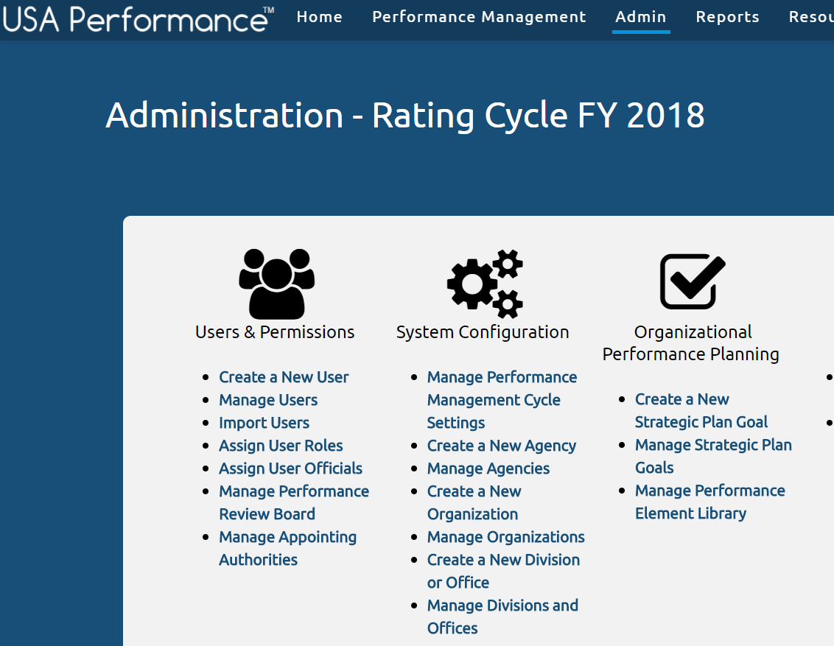
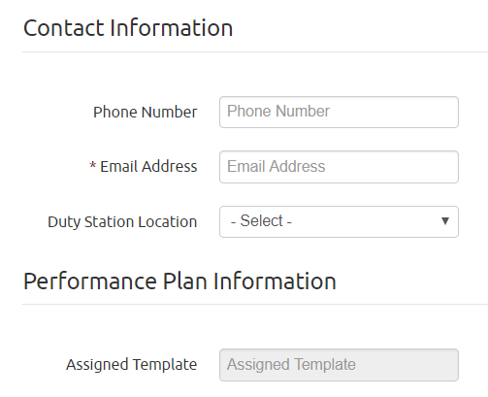
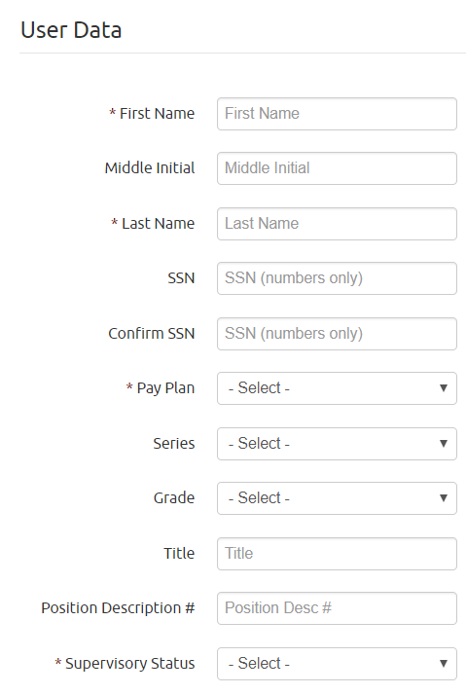
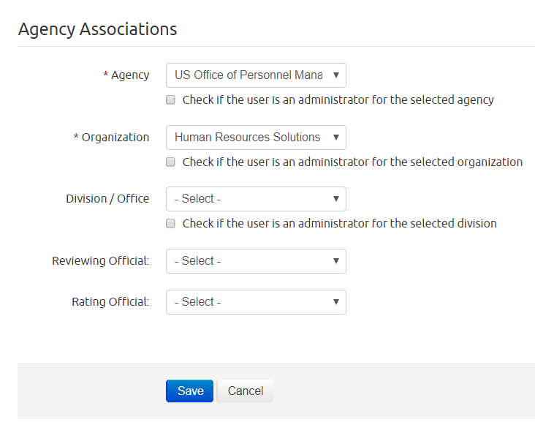
Manually Create a User Profile
Create a New User Account
Manually input all important information
Manage Users
Update an existing user account
New User Emails
Username and Temporary Password

Slide 6
Demo System

Slide 7

Time to Test the System!
Log onto the Test Site
Turn to page [ ] of your workbook

Slide 8
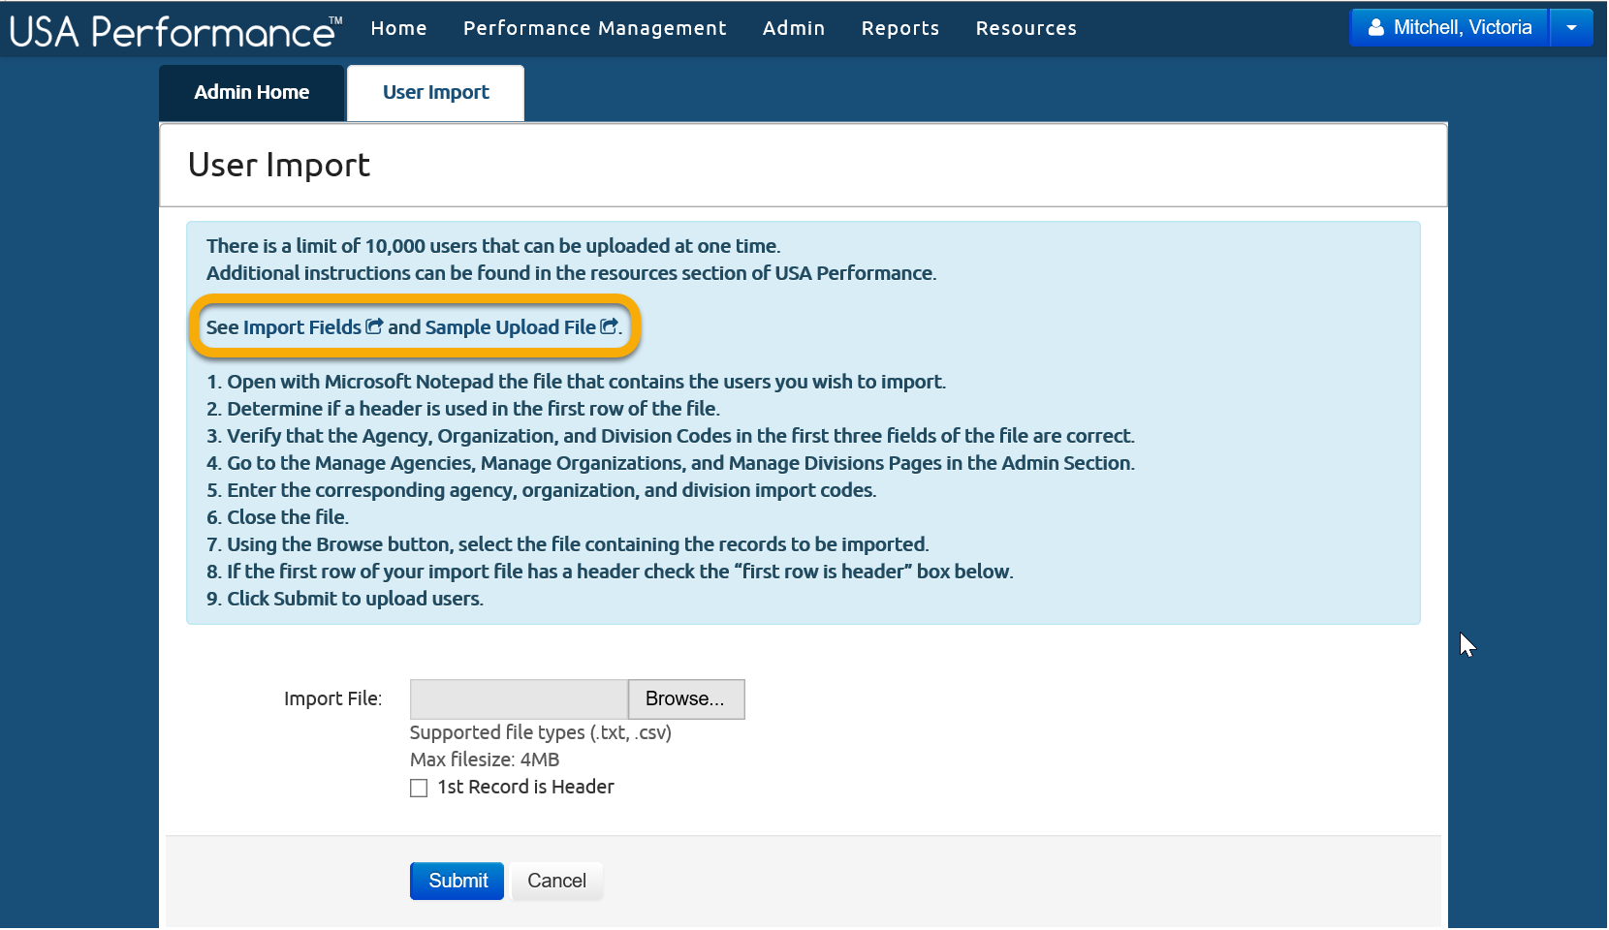
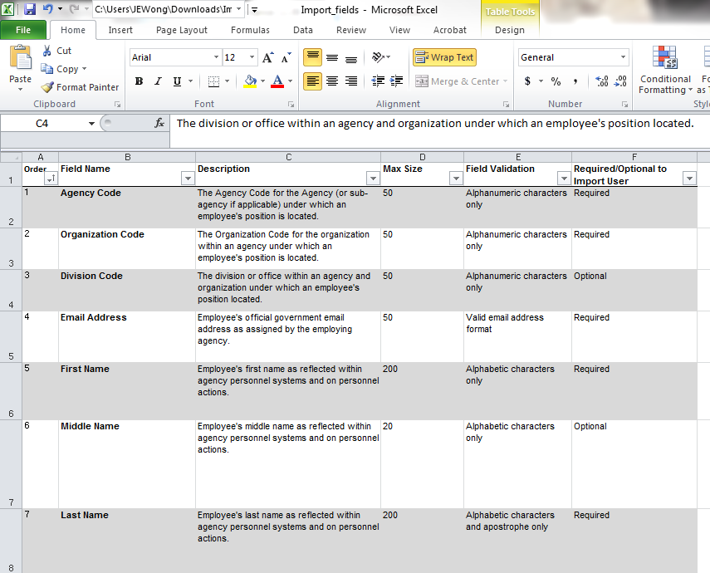
Mass User Import
Navigate to Import Page
Download Excel File
Populate Document
Follow Upload Instructions
Click Submit
Required Fields: Agency Code, Organizational Code, Email Address, First Name, Last Name & Pay Plan
Optional Fields: Division Code, Middle Name, SSN, Series, Grade, Title, PD #, Supervisory Status & Phone Number

Slide 9
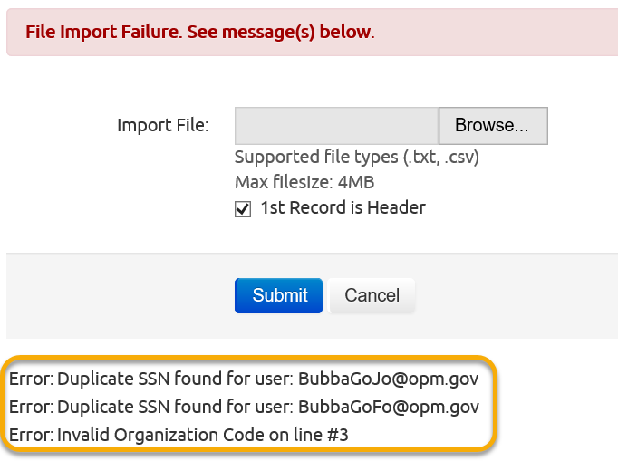
Errors in File Import

Slide 10
Demo System

Slide 11
Time to Test the System!
Log onto the Test Site
Turn to page [ ] of your workbook and Review User Import Document

Slide 12
Assign and Manage User Roles

Slide 13
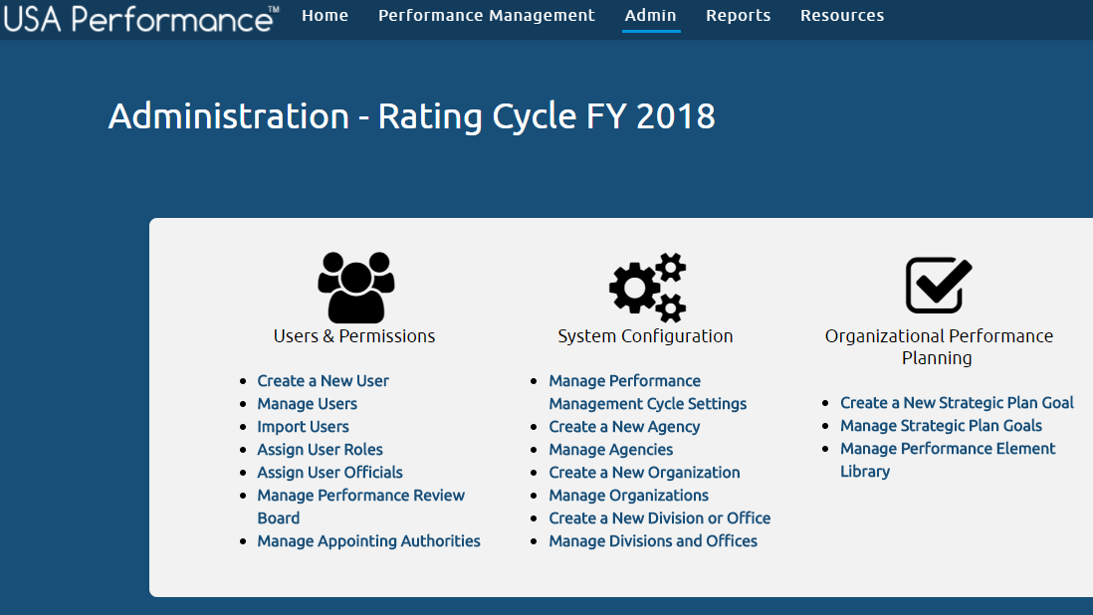
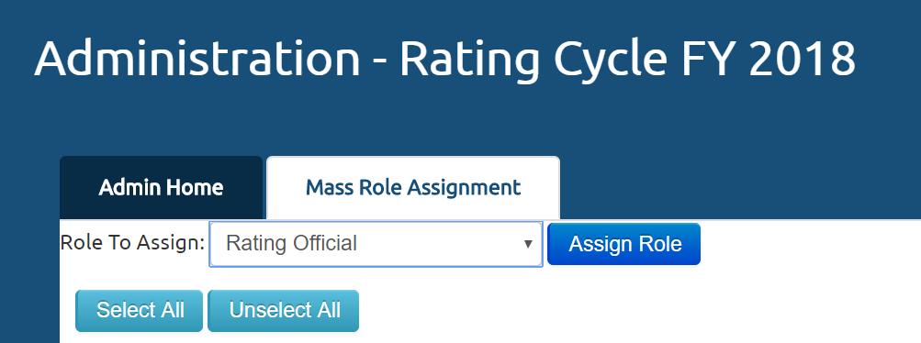
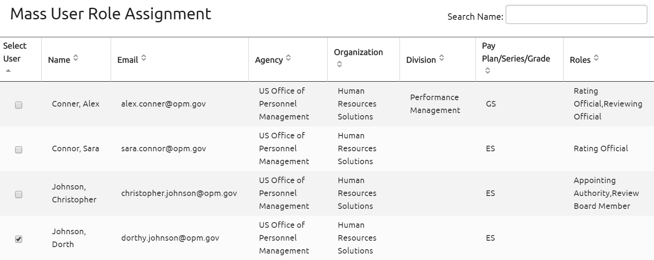
Assign User Roles
Users Roles Options:
Agency, Org, & Division Admin, Rating Official
Reviewing Official
Review Board Member
Review Board Chair
Appointing Authority
User Roles can be assigned during Manual Account Creation or can be assigned in large groups

Slide 14
Demo System

Slide 15
Time to Test the System!
Log onto the Test Site
Turn to page [ ] of your workbook

Slide 16
Assign and Manage User Officials

Slide 17
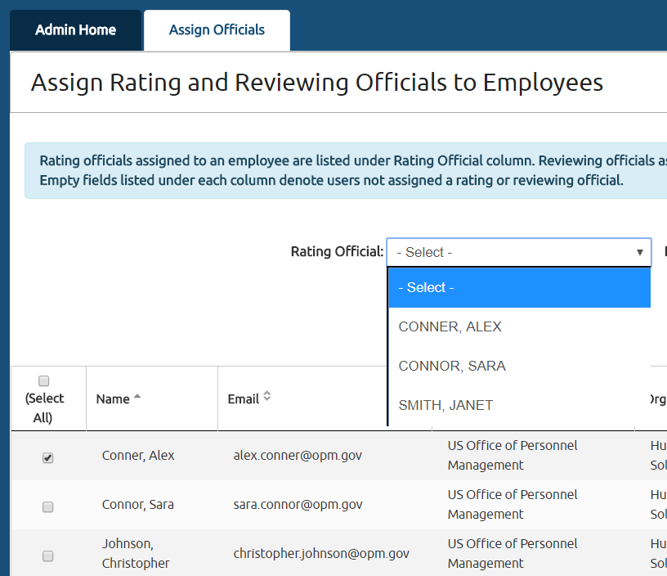
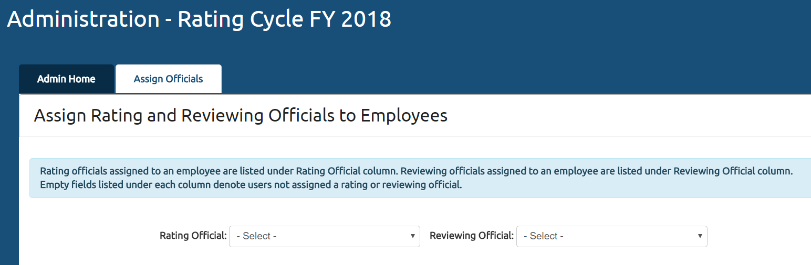
Assign User Officials
Allows Agency Admins to assign a Rating and Reviewing Official to multiple employees

Slide 18
Demo System

Slide 19
Time to Test the System!
Log onto the Test Site
Turn to page [ ] of your workbook

Slide 20
Manage Performance Review Board

Slide 21
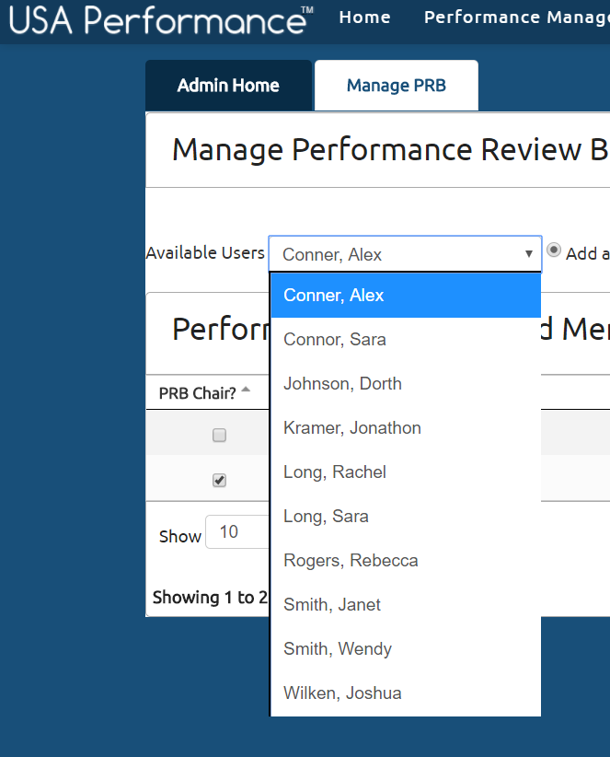
Manage Performance Review Board

Slide 22
Demo System

Slide 23
Time to Test the System!
Log onto the Test Site
Turn to page [ ] of your workbook

Slide 24
Manage Appointing Authorities

Slide 25
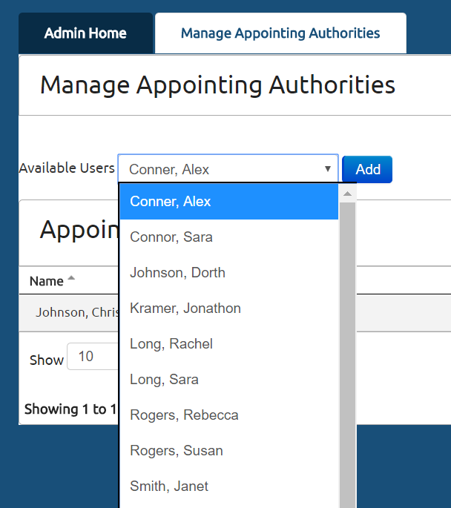
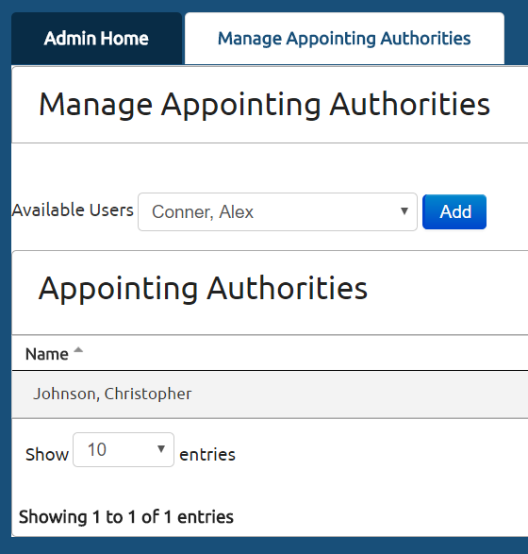
Manage Appointing Authorities

Slide 26
Demo System

Slide 27
Time to Test the System!
Log onto the Test Site
Turn to page [ ] of your workbook

Slide 28
System Configuration

Slide 29
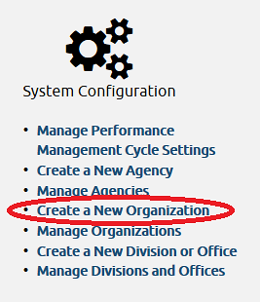
System Configuration

Slide 30
Demo the System

Slide 31
Time to Test the System!
Turn to page [] of your workbook

Slide 32
Organizational Performance Planning

Slide 33
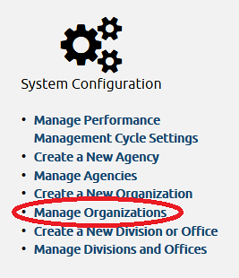
Organizational Performance Planning

Slide 34
Demo the System

Slide 35
Time to Test the System!
Turn to page [] of your workbook

Slide 36

Check on Learning!
Turn to page [INSERT PAGE #] of your workbook

Slide 37
For More Information, Contact:
[insert account manager name]
Account Manager, USA Performance
[insert email]
[insert phone number]

